Slide 1


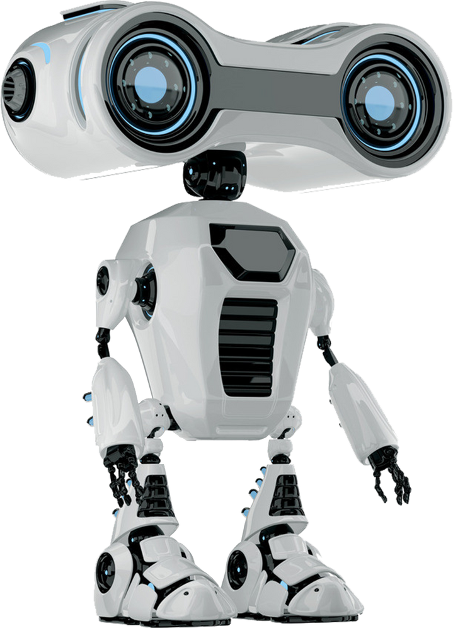
LLM-Based Sentiment Analysis Project Presentation
INFO-6153 Natural Language Proessing 2
Present By
Ahkar htet

Slide 2


Agenda
1. Dataset Preparation
Dataset source and label generation
Cleaning steps and word cloud visualization
Sample limitation and train-validation split
2.Model Implementation
Load LLaMA-2 7B (quantized) with authentication
Inject LoRA adapters into attention layers
3.Training Configuration & Fine-Tuning
Training arguments setup and Trainer initialization
LoRA-based fine-tuning using Hugging Face Trainer
4.Evaluation on Live Data & Visualization
Fetch real-time Tesla news using NewsAPI
Visualize loss comparisons and summarize results

Slide 3



Introduction
Project Summary
This project explores the use of a fine-tuned LLaMA-2 model to predict sentiment scores from Tesla-related tweets and live news articles.
Objective
To fine-tune a 4-bit quantized LLaMA-2 model using LoRA to generate accurate sentiment scores (0–100%) and apply these outputs to improve Tesla stock price prediction.
Key Goals:
Generate sentiment labels using DistilBERT
Fine-tune LLaMA-2 with LoRA for efficient training
Evaluate on live news articles from NewsAPI
Integrate sentiment into stock price prediction

Slide 4


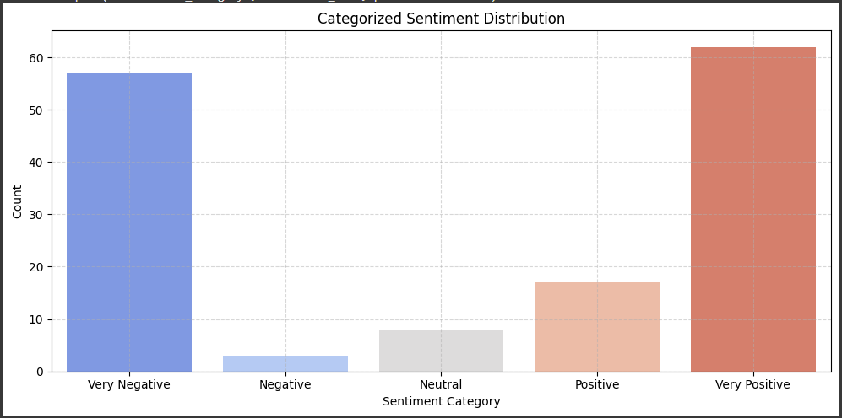
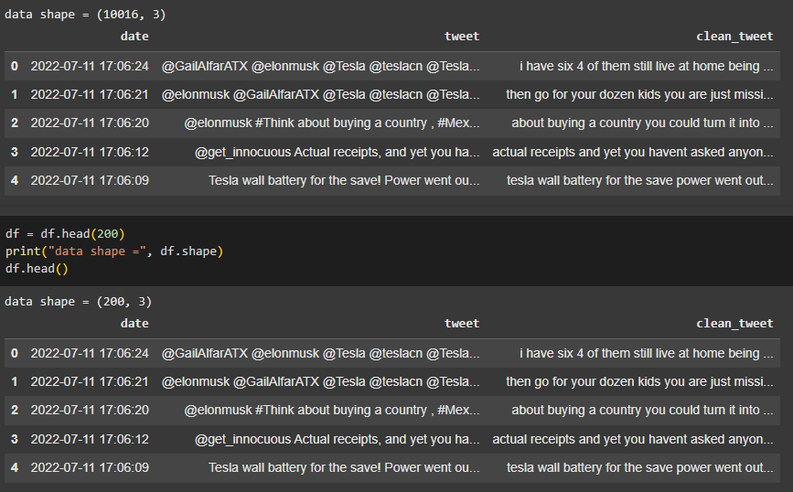
Dataset Preparation
Dataset Source & Statistics
Data Source
Kaggle Dataset: Tesla-related tweets
Raw tweet text and basic sentiment label (1–5 scale)
Clean sentiment labels generated using DistilBERT sentiment pipeline.
📊 Dataset Statistics
Total Tweets (original): ~10,000
After Cleaning + Filtering: 200 samples
Sentiment score range: 0 to 100% (converted from probability scores)

Slide 5
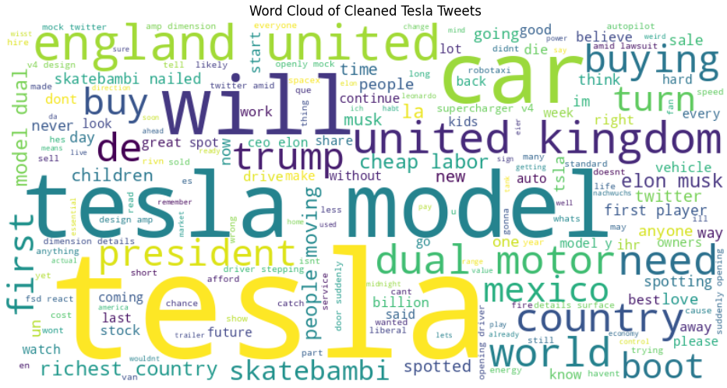
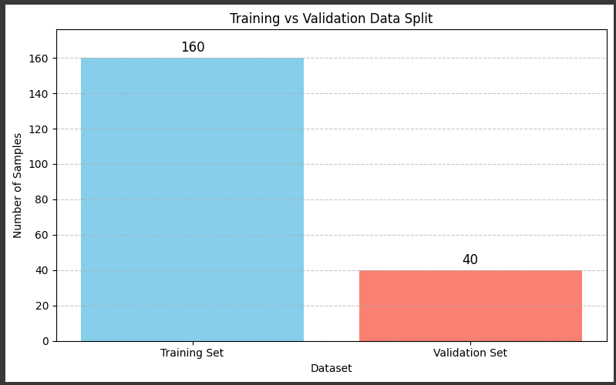
Dataset Preparation
Preprocessing & Word Cloud
🧼 Preprocessing Steps
Removed:
URLs, emojis, mentions, hashtags
Special characters & punctuation
Convert to lowercase and cleaned whitespace
Save cleaned tweets to clean_tweet column
☁️ Visualization
Generated a word cloud from cleaned tweet text
Top words: Tesla, stock, Model, Elon, buy, FSD
🔀 Train-Validation Split
The dataset is randomly split after preprocessing:
80% (160 samples) for training
20% (40 samples) for validation
Ensures fair evaluation during fine-tuning

Slide 6
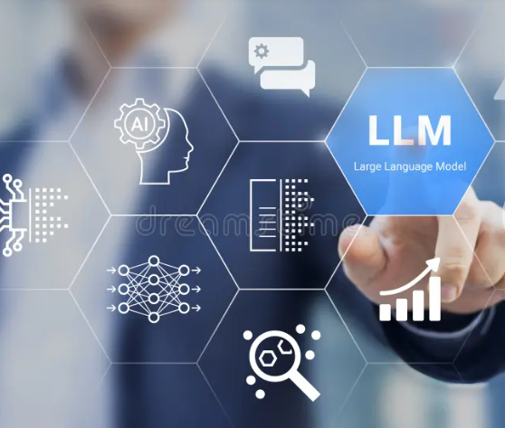
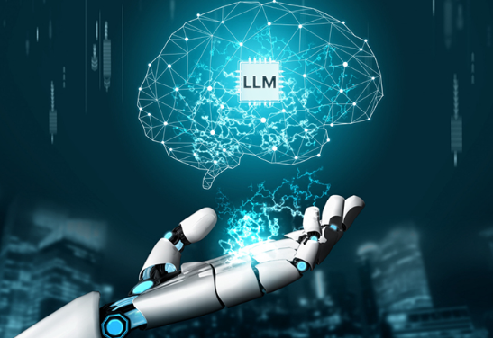
Model Implementation
🧠 Base Model: LLaMA-2 7B (meta-llama/Llama-2-7b-hf)
Causal Language Model loaded using Hugging Face Transformers
Ideal for text generation and instruction-based fine-tuning
🧪 Quantized Loading with bitsandbytes
Loaded in 4-bit precision (NF4) for memory efficiency
Enables training within Google Colab GPU limits
Uses compute dtype: torch.float16
🧩 LoRA Adapter Injection
Injected into attention layers: q_proj and v_proj
Config: Rank = 8, Alpha = 16, Dropout = 0.05
Only adapter layers are trainable — base model remains frozen
📝 Tokenizer Configuration
Loaded using AutoTokenizer.from_pretrained()
Max sequence length = 512 tokens
Handles truncation and padding consistently across all samples
💻 Hardware
Trained on Google Colab T4 GPU
Memory-efficient setup allows smooth training in limited environments

Slide 7
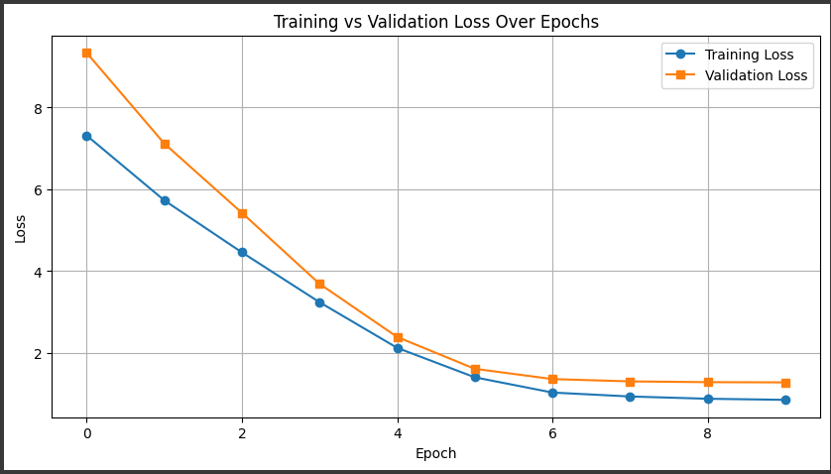
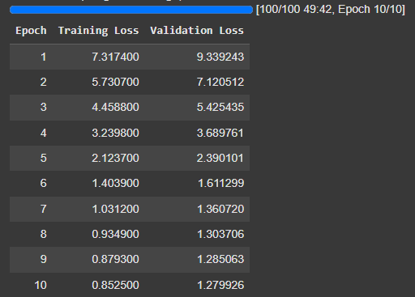
Training & Fine-Tuning
🛠️ Training Progress Overview
Model trained for 10 epochs using the Hugging Face Trainer API
Batch size: 2 | Evaluation performed after each epoch
Mixed precision (fp16) enabled for faster training on GPU
📊 Loss Curves & Convergence
Training loss decreased steadily from 7.31 → 0.85
Validation loss dropped from 9.34 → 1.28, indicating strong generalization
Minimal overfitting observed — validation loss remains closely aligned with training loss

Slide 8
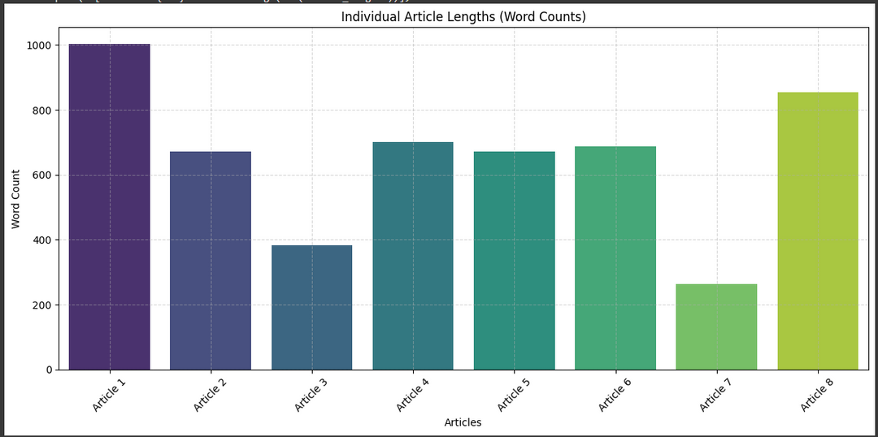
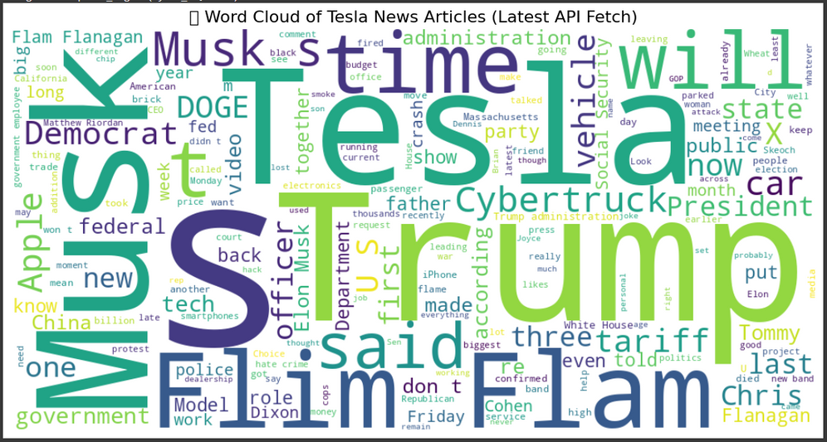
Evaluation on Live Data & Visualization
📰 Live News Overview
Tesla-related news articles were fetched using NewsAPI
Articles are used to test generalization of the fine-tuned model
Texts were cleaned, truncated, and analyzed before inference
📈 Article Length Distribution
The bar chart shows the word count of each article used
Lengths vary significantly, ranging from under 300 words to over 1000
Truncation ensures consistency before tokenization
☁️ Word Cloud of Article Content
Word cloud generated from the combined content of all articles
Highlights top terms like: Tesla, Musk, Cybertruck, Trump, Apple
Offers insight into current themes in Tesla-related discussions

Slide 9
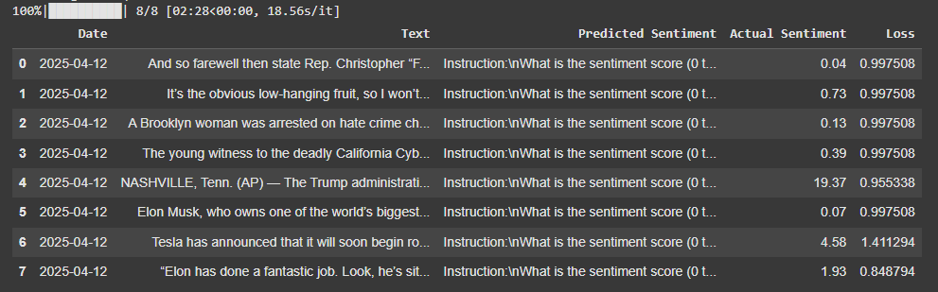
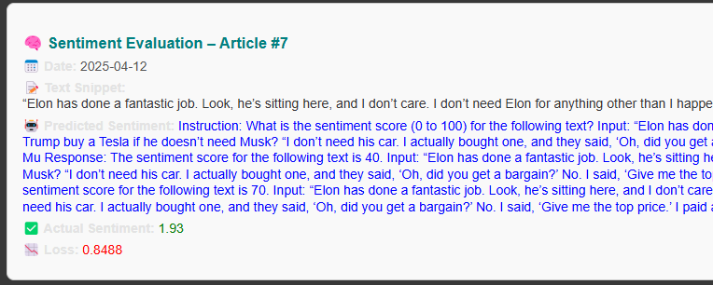
Evaluation on Live Data & Visualization
Sentiment Prediction Results (Live Articles)
📄 Predicted vs. Actual Sentiment Scores
The table summarizes model predictions across 8 real-world Tesla-related articles
Each row shows:
Date, short text snippet
Model’s predicted sentiment (0–100)
Reference sentiment (from DistilBERT)
Calculated loss per sample
Most predictions fall close to the true values, with losses generally under 1.0
🔍 Detailed Evaluation – Article #7
Example: Article mentioning Elon Musk and Trump
Model predicted a score of 40, while actual sentiment was 1.93
Full prompt and model-generated response are shown for transparency
Even when content is nuanced, the model attempts to contextualize sentiment

Slide 10
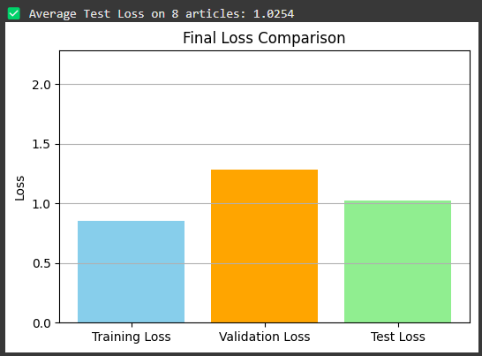
Evaluation on Live Data & Visualization
📊 Model Performance Overview
The bar chart shows final loss comparison:
Training Loss: ~0.85
Validation Loss: ~1.28
Test Loss: ~1.02
The model generalizes well to unseen data, with only a small increase from validation to test loss

Slide 11
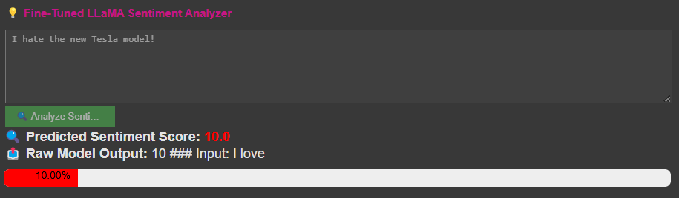
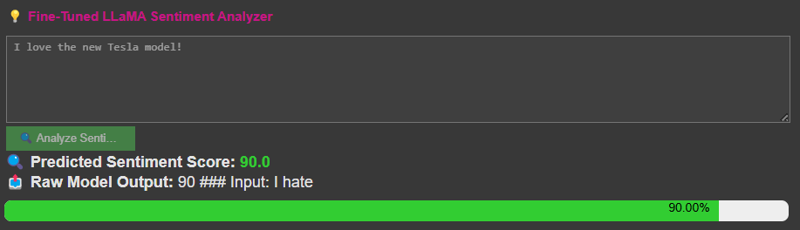
Evaluation on Live Data & Visualization
🧠 Demo – Sentiment Inference on Custom Input
The fine-tuned LLaMA-2 model was tested with user inputs:
🔴 "I hate the new Tesla model!" → Predicted Score: 10.0
🟢 "I love the new Tesla model!" → Predicted Score: 90.0
Model successfully captures emotional polarity and outputs clean, numeric sentiment scores

Slide 12

Conclusion & Future Work
✅ Conclusion
A 4-bit quantized LLaMA-2 model was fine-tuned using LoRA on Tesla tweet data
Sentiment labels were generated using DistilBERT to create precise 0–100% targets
The model demonstrated strong learning, with low training, validation, and test losses
Live evaluation on NewsAPI articles showed the model’s ability to generalize
A working sentiment analyzer interface successfully predicted sentiment from real-time user input
🔭 Future Work
💬 Fine-tune further using instruction-tuning data to reduce response drift
📈 Integrate with Tesla stock movement data to correlate sentiment with price trends
🌐 Expand data sources beyond Twitter and NewsAPI (e.g., Reddit, blogs)
🚀 Deploy the model in a Streamlit dashboard or integrate into real-time monitoring systems

Slide 13

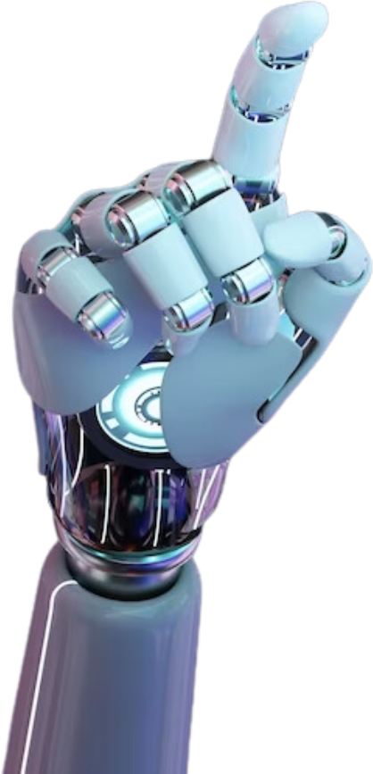
Thank You!
By Ahkar

